Slide 1
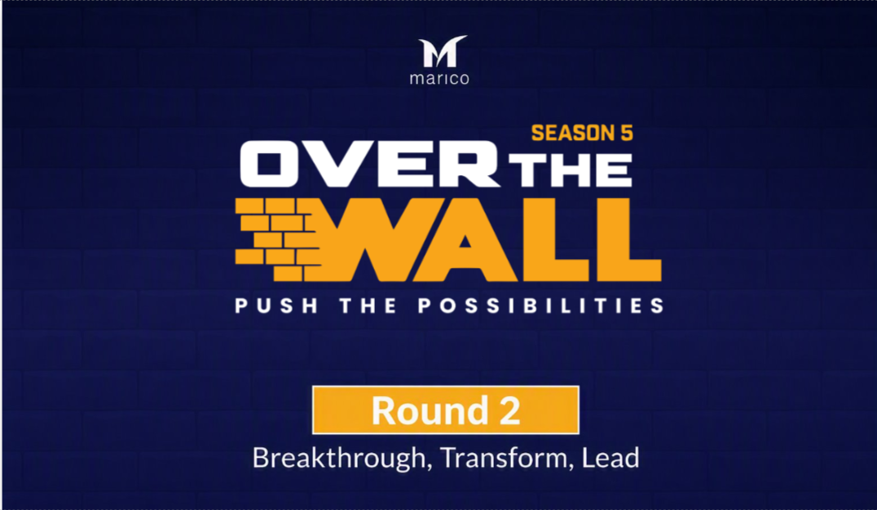

Slide 2

The examples shared in the following template are fictional scenarios given for better understanding and do not reflect the exact quality of business proposals expected from participants.
E.G: We have taken cricket shoe as an example.

Slide 3
Business Plan

Slide 4
  Competitive Landscape
The Competitive Landscape refers to the options a customer could choose from a product market. A person may play cricket wearing different kinds of shoes like running shoe, casual shoe, sometimes even formal shoe or sandal. So, the entire footwear market becomes the universe. An initial approximation of the overall market size would lead to better outcome in terms of product-market fit.
For example, the approximate market size, competitor brands, nature of brands (imported or local), etc. of the Bangladesh footwear market.

Slide 5
  New Opportunities Identification
E.G. Based on primary and secondary research, there are few options catering to cricket players specifically. These are all imported and cater to premium segment.

Slide 6
  Consumer Understanding and Insights
Set your target group for your product. Consider gender, age bracket, socio economic class, geography, etc. Where it will be used? What do the customers want?
E.G. Cricket shoes are catered to cricket players for using on the cricket field specifically. The players’ age range from 15 to 39 years old, are targeted to both men and women.

Slide 7
  Your Big Idea
The core theme of your product.
E.G. Our cricket shoes will be of two variants, one is perfect for the pitch and another is perfect for rest of the field.

Slide 8
  Brand Definition and Category Fit
What will your brand stand for? Luxury, comfort, functionality, value for money, etc.? Come up with a brand personality.
Does it belong in an existing category or is it in a new category?
E.G. Cricket shoes belong in the athletic shoes category.

Slide 9
  Market / Opportunity Size of the Idea
Consider whether your product is mass/niche product. How many people can this product reach? What is the age group that will be using cricket shoes?
E.G. Cricket shoes are a niche product.

Slide 10
  Value Proposition of the Idea
What does your brand promise to your customers?
Our cricket shoes offer 3 primary value propositions: innovation, customization, and brand/status.

Slide 11
  Unique Selling Proposition
What makes your product different?
E.G. Our cricket shoes offer the highest quality and functionality to cricket players. The shoes will offer comfort on the sole of the foot and grip with the toes and ball of the foot. The front of the shoe will be fitted with 7 spikes, which will grip the surface when players play shots and run between the wicket. Faster bowlers need spikes on their cricket shoes on the front and the back. Players that field on a damp surface from rain or dew will also need full spikes or longer.

Slide 12
Execution Plan

Slide 13
  Marketing Task Definition
Web / social / electronic / print media campaigns

Slide 14
  Sales Strategy
Overall Sales Execution strategy
General Trade / Store
Modern Trade / Supermarkets
E-Commerce / Online Shop

Slide 15
  Supply Chain Strategy
Raw materials and packaging materials sourcing strategy
Production Strategy

Slide 16
Financial Plan

Slide 17
  Revenue Model
Current and projected revenue for the next 3 years

Slide 18
  Profit and Loss Road Map
Road Map for next 3 Years

